Slide 1
Name : SADHANA SIBI S
Reg No: 410121104040
Department: Computer Science and Engineering
College Name : Adhi College of Engineering and
Technology
Final Project

Slide 2
PROJECT TITLE:-
Handwritten Digit Generation Using GAN Model
Presented by: S.Sadhana sibi ,
CSE-III-year,
Adhi college of engineering and technology.

Slide 3


AGENDA
Problem Statement
Project overview
Who are the end users?
Solution and value propotion
Uniqueness of solution
Modeling
Results
3/21/2024 Annual Review

Slide 4

PROBLEM STATEMENT
Problem Statement :
The project aims to develop a Generative Adversarial Network (GAN) capable of generating realistic handwritten digits resembling those from the MNIST dataset. The MNIST dataset consists of 28x28 grayscale images of handwritten digits (0-9), and the objective is to create a GAN that can produce synthetic images resembling these digits.
Make a computer that draws realistic numbers like humans.
Make sure the numbers look different but still easy to read.
Create many types of numbers with different styles.
Teach the computer to make new numbers it hasn't seen before.
Build a system that can make lots of numbers quickly and without mistakes.
Help other computer programs learn by using these numbers.
Test how good other programs are at recognizing numbers using our made-up numbers.
Objective:

Slide 5

PROJECT OVERVIEW
Objective: The objective is to develop a GAN model that can generate diverse and realistic handwritten digit images to aid in training machine learning models for digit recognition tasks.
Steps:
Research: Conduct an in-depth review of existing literature and techniques related to GANs, image generation, and handwritten digit recognition.
Data Collection: Gather a large dataset of handwritten digit images for training and evaluation purposes, ensuring diversity in writing styles and variations.
Model Design: Design a GAN architecture suitable for generating realistic handwritten digits, considering factors such as network depth, layer configurations, and activation functions.
Training: Train the GAN model on the collected dataset, optimizing parameters to generate high-quality digit images with diverse styles.
Evaluation: Evaluate the trained model's performance using quantitative metrics such as inception score and qualitative assessments by human evaluators..
Deployment: Deploy the trained GAN model to generate synthetic handwritten digit datasets for use in training and evaluating machine learning models.
Documentation: Document the entire process, including data sources, model architecture, training procedures, and evaluation results, for reproducibility and future reference.

Slide 6
WHO ARE THE END USERS?
The end users of the handwritten digit generation tool encompass various individuals and groups involved in machine learning, education, software development, and related fields.

Slide 7

YOUR SOLUTION AND ITS VALUE PROPOSITION
Solution:
Methodology:
Utilize GANs for handwritten digit generation.
Train GAN model with dataset preprocessing and architecture design.
Employ adversarial training and stabilization techniques.
Evaluation Metrics:
Assess quality using FID, IS, and visual inspection.
Value Proposition:
High-Quality Synthetic Data:
Augment existing datasets for diverse training.
Cost & Time Savings:
Reduce reliance on manual labeling, saving resources.
Customization & Adaptability:
Control parameters for specific applications.
Privacy Preservation:
Mitigate privacy concerns with synthetic data.
Innovative Applications:
Empower research and development in OCR and ML tasks.

Slide 8

THE WOW IN YOUR SOLUTION
Unique Aspects of Our Solution:
Conditional Generation with Style Transfer:
Our solution not only generates handwritten digits but also allows users to specify the desired digit and style, offering unparalleled customization.
Interactive User Interface:
We provide an intuitive interface for users to input preferences and visualize real-time outputs, enhancing user engagement and facilitating exploration.
Adaptive Learning Mechanisms:
By incorporating adaptive learning, our model dynamically adjusts its generation process based on user feedback, ensuring continuous improvement and personalized results.
Privacy-Preserving Generation:
We employ privacy-preserving techniques to generate synthetic handwritten digits while safeguarding the privacy of the original data, distinguishing our solution as privacy-conscious.
Multimodal Generation Capability:
Our solution extends beyond traditional digit generation to include additional modalities such as colors, textures, and backgrounds, enriching the generated outputs and expanding potential applications.
Transfer Learning Integration:
Through the integration of transfer learning, we leverage pre-trained models to accelerate training and enhance the quality of generated digits, setting our solution apart in terms of efficiency and performance.
3/21/2024 Annual Review
8

Slide 9
MODELLING
Data Preprocessing:
I preprocess the MNIST dataset by normalizing pixel values and applying augmentation techniques to enhance model robustness.
Architecture Design:
The Discriminator and Generator models are designed with multiple layers and activation functions to capture intricate features of handwritten digits.
Training Procedure:
Adversarial training is employed to optimize the models iteratively, alternating between training the Discriminator and Generator networks.
Evaluation Metrics:
Model performance is evaluated using metrics such as Frechet Inception Distance (FID) and visual inspection of generated digit images.
9

Slide 10
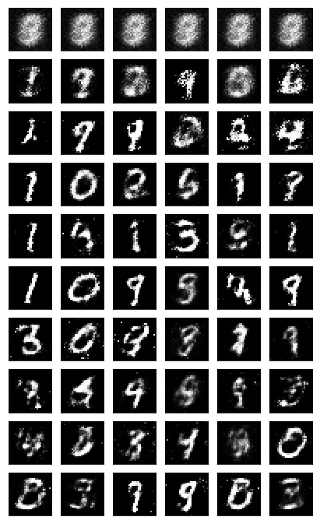
RESULTS
10

